Slide 1
Database Management
Introduction
Course IT 641: Data Management and Governance
Copyrights and original material belongs to: Prof. Peter Wood
Email: ptw@dcs.bbk.ac.uk
Web: http://www.dcs.bbk.ac.uk/~ptw/

Slide 2
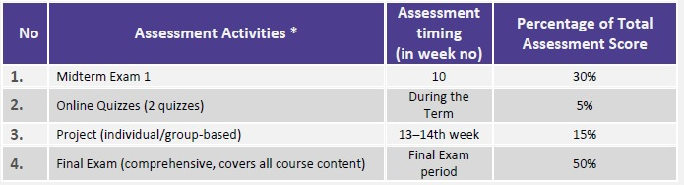

Slide 3
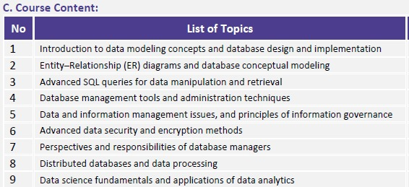
Topics related to data science, big data storage and processing, decision making are also part of the flow of lectures

Slide 4
What is data management and data governance?
Database Management
Introduction
In the simplest terms, data governance establishes policies and procedures around data, while data management enacts those policies and procedures to compile and use that data for decision-making

Slide 5
What is data management and data governance?
Database Management
Data management is the creation and implementation of architectures, policies, and procedures that manage the full data lifecycle needs of an organization. Common elements of data management are:
Data preparation: is the process of cleaning and transforming raw data to allow for accurate analysis. This critical first step sometimes gets missed in the rush for reporting and analysis, and organizations find themselves making bad decisions with bad data.
Data pipelines: are used to automatically transfer data from one system to another.
Data extract, transform, load (ETL): means transforming data to load in an organization’s data warehouse. ETLs often are automated processes once they are built and usually require preparation and pipeline work.
Data catalogs: help create a complete picture of the data by managing metadata and also making data easier to find and track.
Data warehouses: provide a clear route to data analysis by consolidating all data sources.
Data architecture: will be the formal structure for managing data flow.
Data security: consists of the processes put in place to protect your data from unauthorized access or corruption.
Introduction

Slide 6
What is data management and data governance?
Database Management
Data governance is a key component of data management—the practice of managing how the data that is being managed is processed through the organization. Data governance helps answer questions like:
Who has ownership of the data?
Who can access what data?
What security measures are in place to protect data and privacy?
How much of our data is compliant with new regulations?
Which data sources are approved to use?
Introduction

Slide 7
Why study data management?
In other words, why study database management?
Database Management
Introduction
The database market is huge
There’s a big demand for database skills 3.Managing data is a fundamental need for most
applications

Slide 8
What is a Database?
Database Management
Introduction
A database is a collection of persistent data
A database models part of the real world
A database is, in general, a shared resource

Slide 9
What is a Database Management System (DBMS)?
Database Management
Introduction
A DBMS is specialised software which is responsible for efficient storage and retrieval of large amounts of data in a database, allowing it to persist over long periods of time.
(A DBMS is also often referred to simply as a database system.)

Slide 10
Why Do We Need a DBMS?
Database Management
A DBMS is a software package that handles all the interaction of applications with the database.
It saves programmer time by providing a declarative
query language, e.g. SQL.
It saves programmer time by automatically checking
constraints.
It saves maintenance time by ensuring data independence.
It provides concurrent access to the database for multiple, simultaneous users.
It provides automatic recovery from failure.
It provides security to ensure appropriate access to data.
Introduction

Slide 11
Exploration Task (10 minutes):
Types of DBMS
https://www.includehelp.com/dbms/types-of-database-management-system.aspx

Slide 12
Three levels of Abstraction
Database Management
A DBMS hides details from the user/programmer using three levels of abstraction:
Introduction
view1
view2
· · ·
view n
logical level
physical level
physical: how data is stored.
logical: based on a data model.
view: what programs or users see.

Slide 13
Instances and Schemas
Database Management
Databases change over time as information is inserted and deleted.
The collection of data stored in a database at any moment in time is called an instance of the database.
The overall design of the database is called the database schema.
Schemas change infrequently.
Physical schemas describe databases at the physical level.
Logical schemas describe databases at the logical level.
Schemas at the view level are sometimes called
subschemas.
Introduction

Slide 14
Types of DBMS users
Database Management
Introduction
End users - simply use the database.
Application programmers - develop applications using the database.
Database administrator (DBA) - responsible for database design and performance.

Slide 15
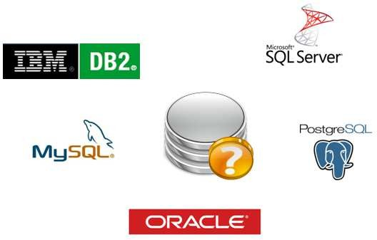
DBMS examples
Database Management
Some of the major players:
Introduction
also various “NoSQL” systems, such as Cassandra, CouchDB, MongoDB, Neo4j, . . .

Slide 16
Data Model
Database Management
Introduction
A data model consists of three components: 1.Structural part.
Integrity part.
Manipulative part - declarative or procedural.

Slide 17
The Relational Data Model
Database Management
Introduction
Structural part - relations.
Integrity part - keys (entity integrity) and foreign keys (referential integrity).
Manipulative part - Structured Query Language (SQL) or the relational algebra.

Slide 18
Other Data Models
Database Management
Introduction
Entity-relationship model
Hierarchical data model - from 1960s and 1970s
Network (CODASYL) data model - from 1960s and 1970s
Object-oriented data model - from 1980s and 1990s
Semi-structured data model (e.g. XML) - from 1990s
Document or key-value models (for NoSQL systems)
- from 2000s

Slide 19
What is Big data:
Exploration Task (10 minutes):

Slide 20
Exploration Task (10 minutes):
Big data storage tools/databases

Slide 21
Exploration Task (10 minutes):
Big data processing tools

Slide 22
Summary
Database Management
Databases are crucial to most organisations.
A DBMS is a sophisticated piece of software that provides the interface between database users and the database itself.
A DBMS has three levels of abstraction: physical, logical and view.
Data independence means that changing data representation at a lower level does not affect a higher level.
A data model has structural, integrity and manipulative parts.
It is important to understand how
  to access and update information in a database, e.g. using SQL
  to design a database based on real-world constraints
  a DBMS provides efficient and concurrent access to data
Introduction

